Slide 1
Organic Chemistry

Slide 2
Crash Course

Slide 3
Warm-Up
Draw the Lewis structure for CARBON.
How many valence electrons does a carbon atom have?
4!!

Slide 4
Organic Compounds
Contain carbon atoms usually bonded to other carbon atoms and hydrogen atoms.
Called HYDROCARBONS
Organic compounds may also contain halogens, nitrogen, oxygen, phosphorus and sulphur

Slide 5
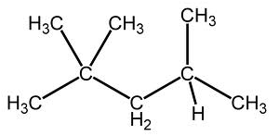
Organic Compounds
Iso-octane
DDT

Slide 6
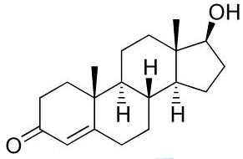
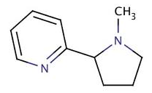
Organic Compounds
Testosterone
Nicotine

Slide 7
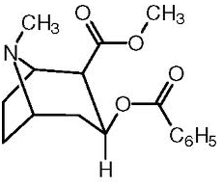
Organic Compounds
Cocaine
Teflon

Slide 8
Organic Compounds
Scientists thought that organic compounds contained a “life force” or “vitality.”
Was proved incorrect in 1828 when an inorganic salt was heated to produce an organic compound (made pee!)

Slide 9
Inorganic Carbon Compounds
CONFUSING!
Even if a compound contains carbon, it may not be classified as an organic compound.
Compound with other non-metals (besides H, N, O, S, P and Halogens)
Compounds with metals

Slide 10
Simple Hydrocarbons
Recall that a carbon has 4 valence electrons
Let me tell you a funny story…
Each carbon atom can form 4 covalent bonds
With so many different ways that a carbon can bond, there are millions of known organic compounds
How to DRAW simple hydrocarbons..

Slide 11
Simple Hydrocarbons
Alkanes
Hydrocarbons containing only single bonds.
They are saturated – there is no room for other atoms to bond to the carbon skeleton

Slide 12
Simple Hydrocarbons
Alkanes
10 Straight-Chain Alkanes You Need to Know
C_{n}H_{2n+2}

Slide 13
Simple Hydrocarbons
Alkanes
# of C Atoms | Prefix
1 | Meth-
2 | Eth-
3 | Prop-
4 | But-
5 | Pent-
6 | Hex-
7 | Hept-
8 | Oct-
9 | Non-
10 | Dec-

Slide 14
Simple Hydrocarbons
Alkanes
# of C Atoms | Prefix | Alkane
1 | Meth- | Methane
2 | Eth- | Ethane
3 | Prop- | Propane
4 | But- | Butane
5 | Pent- | Pentane
6 | Hex- | Hexane
7 | Hept- | Heptane
8 | Oct- | Octane
9 | Non- | Nonane
10 | Dec- | Decane

