Slide 1
Organic Chem
Please collect the second set of notes from the front of the room

Slide 2
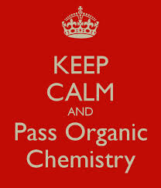
Organic Chemistry

Slide 3
Warm-Up
Reminder! the Lewis structure for CARBON.
Reminder! How many valence electrons does a carbon atom have?
4!!

Slide 4
Simple Hydrocarbons
Alkanes
# of C Atoms | Prefix | Alkane
1 | Meth- | Methane
2 | Eth- | Ethane
3 | Prop- | Propane
4 | But- | Butane
5 | Pent- | Pentane
6 | Hex- | Hexane
7 | Hept- | Heptane
8 | Oct- | Octane
9 | Non- | Nonane
10 | Dec- | Decane

Slide 5
Naming Simple Alkanes

Slide 6
Naming Simple Alkanes
Find the longest continuous chain of carbon atoms. It does not have to be in a straight line. This is the “parent” chain.
State the number of carbon atoms using the appropriate prefix and the ending “ane.”

Slide 7
Naming Simple Alkanes
Branches are called “alkyl” groups. Number the carbon atoms in the parent chain starting at the end closest to the branches

Slide 8
Naming Simple Alkanes
Name each branch.
Give a prefix according to the number of carbon atoms it contains. Branch names end in “yl” instead of “ane”

Slide 9
Naming Simple Alkanes
Name each branch.
List the branches in alphabetical order. If more than one branch have the same number of carbon atoms, use the prefixes “di” (two), “tri” (three) and “tetra” (four).

Slide 10
Naming Simple Alkanes
State the name of the alkane by naming each branch, then naming the parent. Use commas between numbers and hyphens between numbers and branches.
2-methylbutane

Slide 11
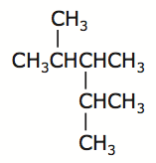
Naming Simple Alkanes
Parent Chain.
Number the parent chain.
Name the branches.
Name the compound
2,3,4-trimethylpentane

Slide 12
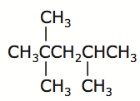
Naming Simple Alkanes
Parent Chain.
Number the parent chain.
Name the branches.
Name the compound
2,2,4-trimethylpentane

Slide 13
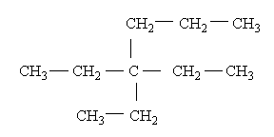
Naming Simple Alkanes
Parent Chain.
Number the parent chain.
Name the branches.
Name the compound
3,3-diethylhexane

Slide 14
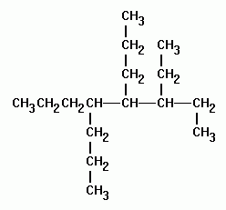
Naming Simple Alkanes
Parent Chain.
Number the parent chain.
Name the branches.
Name the compound
3-ethyl-4,5-dipropyloctane

