Slide 1
Functional Groups II

Slide 2
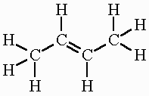
Cis - Trans Isomerism
Draw the structure for 2-butene

Slide 3
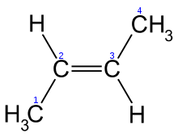
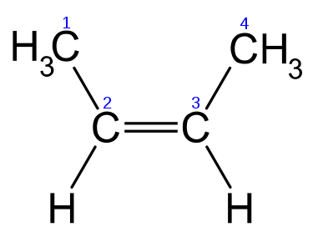
Cis - Trans Isomerism
Is there any other way to draw this structure?
trans-2-butene cis-2-butene

Slide 4
Cis - Trans Isomerism
So what’s the difference?
A lot!
The double bond “locks” the molecule in place and changes the properties of the compound.
One compound may be life saving… another may be deadly…

Slide 5
Cis - Trans Isomerism
Naming Cis-Trans Alkene’s:
The parent chain must contain the double bond.
The name of the parent chain ends with “ene” instead of “ane”.
Determine if the molecule is “cis” (same side) or “trans” (across) AT the double bond and include it at the front of the parent chain
Include the number where the double bond starts before the parent chain

Slide 6
Cis - Trans Isomerism
And as always…
Name and identify positions of the branches.
Name the compound.

Slide 7
Naming Cis-Trans Isomers
Parent Chain.
Number parent chain.
Name the branches.
Name the compound
trans-2-pentene

Slide 8
Naming Cis-Trans Isomers
Parent Chain.
Number parent chain.
Name the branches.
Name the compound
4-methyl-cis-2-heptene

Slide 9
Cis-Trans Isomers
Question: How would you name Cis-Trans Isomers for Alkynes?

Slide 10
Functional Groups
So far….
FG #1: Alkyl Halides R-X
FG #2: Alcohols R-OH
Next….
FG #3: Aldehydes RH=O
FG #4 Ketones R=O

Slide 11
FG#3: Aldehydes
Organic compounds containing an oxygen at the END of a parent chain double bonded to a carbon.
To name aldehydes remove the “-e” from the end of the parent chain and replace it with “-al”

Slide 12
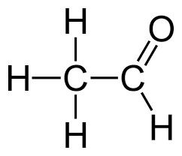
Naming Aldehydes
Parent Chain.
Number parent chain.
Name the branches.
Name the compound
1-ethanal

Slide 13
Naming Aldehydes
Parent Chain.
Number parent chain.
Name the branches.
Name the compound
2-chloro-1-pentanal

Slide 14
FG#4: Ketones
Organic compounds containing an oxygen in the middle of a parent chain double bonded to a carbon.
To name aldehydes remove the “-e” from the end of the parent chain and replace it with “-one”

Slide 15
Naming Ketones
Parent Chain.
Number parent chain.
Name the branches.
Name the compound
2-pentanone

Slide 16
Naming Ketones
Parent Chain.
Number parent chain.
Name the branches.
Name the compound
3-methyl-2-butanone

Slide 17
Naming Ketones
Parent Chain.
Number parent chain.
Name the branches.
Name the compound
2,3-hexandione

