Slide 1
Ionic Bonding Lattice Energy
Michael
Tian
Koya

Slide 2
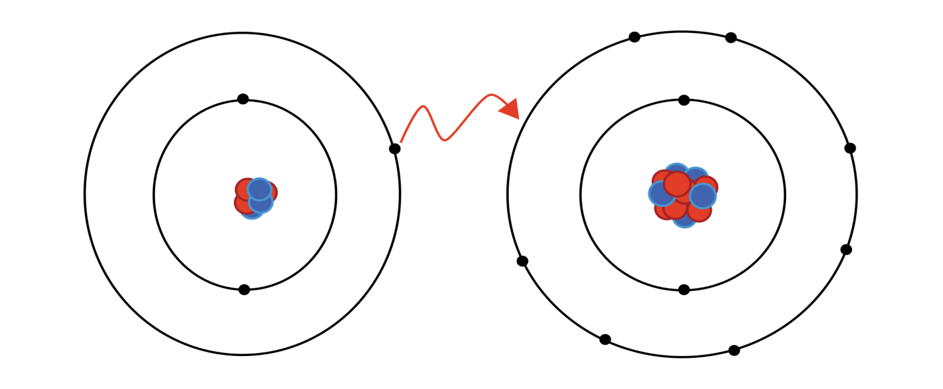
Ionic Bonding
Definition: The complete transfer of valence electron(s) between atoms. It’s a type of chemical bond that creates two oppositely charged ions. Typically an ionic bond happens between a metal and a non-metal, where the metal loses electrons to the non-metal, resulting in a cation and a anion.

Slide 3
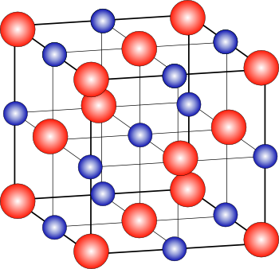
Ionic Bonding
Na(s) + ½Cl2 (g) → NaCl(s) ∆Hºf = –410.9 kJ/mol
Reaction is exothermic, product is more stable than reactants.
The product of the ionic bonding forms a solid array of cations and anions called a crystal lattice.
The stability of the ionic compound comes from the attraction between ions of unlike charge. This is given by the equation:
$$Lattice energy= \frac{kq_{1}q_{2}}{d}$$

Slide 4
Lattice Energy

Slide 5
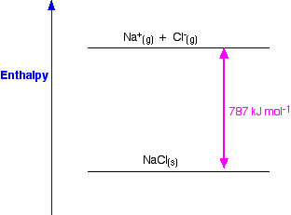
Lattice Energy (force)
The energy required to separate one mole of a solid ionic compound into gaseous ions is called the lattice energy, ∆H_{lattice.}
Lattice energy depends on the charge on the ions and the size of the ions.
Two definitions
Both are about enthalpy (heat) change per mole when changing states.
lattice formation enthalpy
One from gas to solid, downward, so it is -787 kJ mol⁻¹
lattice dissociation enthalpy
One from solid to gas, upward, so it will be 787 kJ mol⁻¹
Notes:
http://www.chemguide.co.uk/physical/energetics/lattice.html

Slide 6
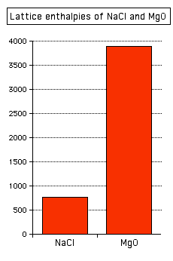
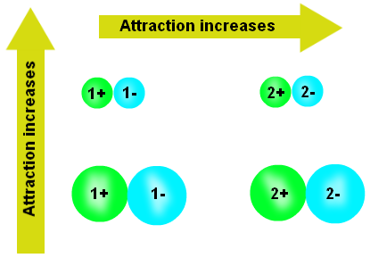
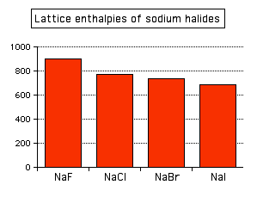
Change of Lattice energy
More charge, more energy
Less radius, more energy
E$= \frac{kq_{1}q_{2}}{d}$
Notes:
NaCl has less charge than MgO
NaF NaCl NaBr Nal, Down the chart

Slide 7
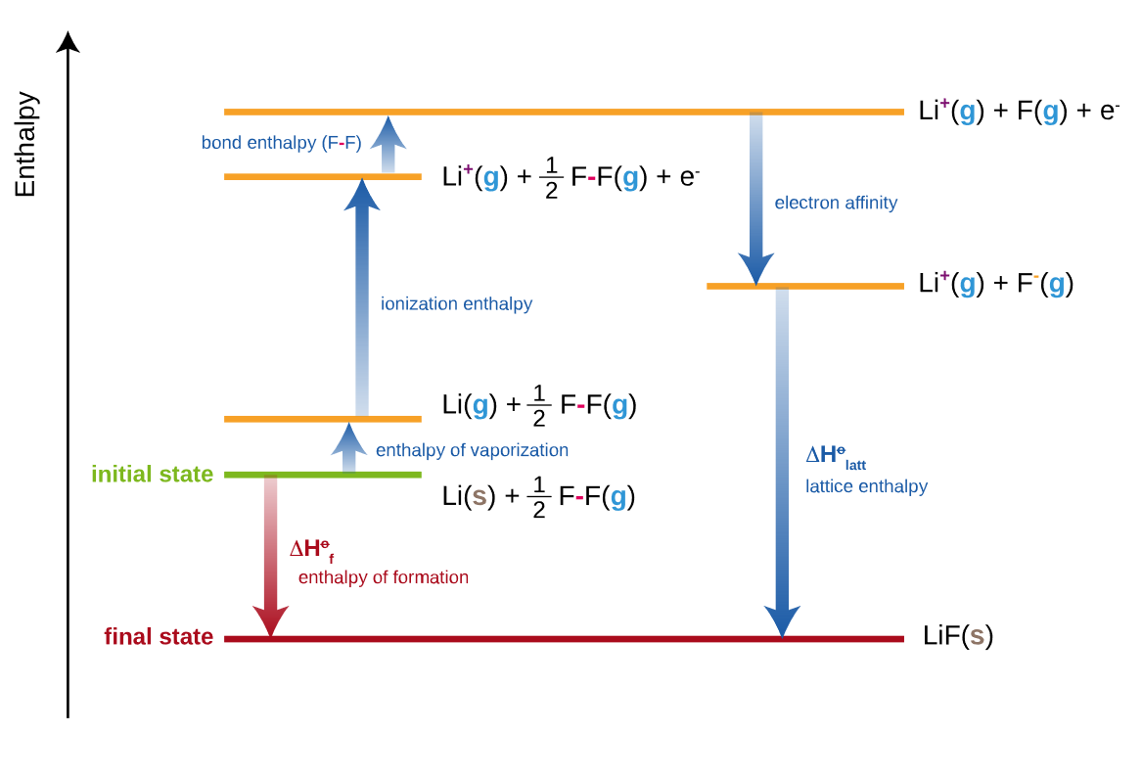
Born–Haber cycle
An approach that analyzes reaction energies
Used for calculating lattice enthalpy
Total enthalpy change = 0
Lattice energy cannot be measured directly, instead we use the previous energies to calculate lattice energy

Slide 8
Question
Why does sodium chloride have a lower melting point than magnesium chloride?
1. Its positive ions are larger but have a smaller charge
2. Its positive ions are smaller and have a smaller charge
3. Its positive ions are smaller but have a larger charge
What is the formula for magnesium chloride?
MgCl
Mg₂Cl₂
With a big radius means it has a higher distance, less charge will bring q1q2 down and the total result is less bonding force, and lower melting point.
MgCl₂

Slide 9
Questions
Aluminum has the lowest radius in all other metal elements listed in the question, oxygen has smaller radius than Cl.
The charge increases as there are more ions in the molecule.
So, smaller radius, higher charge, it will result in a higher lattice energy
Which one of the following has the largest lattice energy? LiF, NaF, CaF₂, AlF₃
Which one of the following has the largest lattice energy? LiCl, NaCl, CaCl₂, Al₂O₃
AlF₃
Al₂O₃
E$= \frac{kq_{1}q_{2}}{d}$
Notes:
More

Slide 10
Arrange the following compounds in order of increasing lattice energy: NaF, CaO, CsI
CsI < NaF < CaO
Calcium has a +2 ion and oxygen has –2 ion, while both NaF and CsI possess +1 and –1 charges. Since lattice energy is directly proportional to the charges, CaO would have the largest value. Sodium ion and fluoride ions are smaller than cesium and iodide ions. Since lattice energy is inversely proportional to the size of the ions, CsI would have the lowest value.

Slide 11
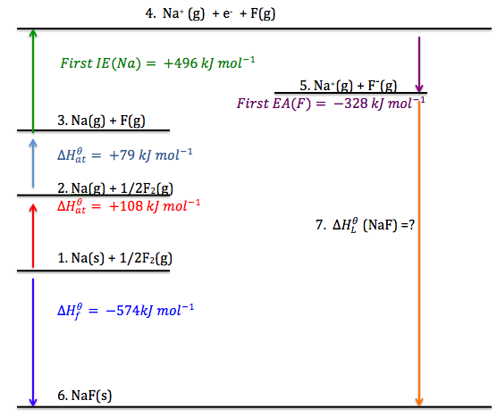
What is the lattice energy in this diagram?
∆Hf+ ∆Hat+ ∆at+First IE(Na)-First EA(F)
=-574+-108+-79+-496+328=-929kj/mol
∆H LE = -929kj/mol

Slide 12
Use the data provided below to calculate the lattice energy of RbCl. Is this value greater or less than the lattice energy of NaCl? Explain.
Electron affinity of Cl = –349 kJ/mol
1 st ionization energy of Rb = 403 kJ/mol
Bond energy of Cl2 = 242 kJ/mol
Sublimation energy of Rb= 86.5 kJ/mol
ΔHf [RbCl (s)] = –430.5 kJ/mol
Rb (s) + ½ Cl2 (g) → RbCl (s)
This equation can be written as the sum of the following:
Rb (s) → Rb (g) sublimation ΔH1= +86.5 kJ/mol
Rb (g) → Rb+ + e– 1st ionization energy Δ H2= +403 kJ/mol
½ Cl2 (g) → Cl bond energy of Cl2 Δ H3= +121 kJ/mol
Cl + e– → Cl– electron affinity of Cl Δ H4= –349 kJ/mol
Rb+ + Cl–→ RbCl lattice energy Δ H5= ???
Rb (s) + ½ Cl2 (g) →RbCl (s)
Δ Hf = –430.5 kJ/mol
Δ Hf = Δ H1 + Δ H2 + Δ H3 + Δ H4 + Δ H5
Lattice energy = Δ H5 = Δ Hf – (Δ H1 + Δ H2 + Δ H3 + Δ H4)
= –430.5 – (86.5 + 403 + 121 – 349)
= –692 kJ
This value would be expected to be smaller than NaCl. This is because Rb is a larger ion than Na and would be further apart from the anion. Lattice energy is inversely proportional to the distance between the ions.

Slide 13
Another quiz http://ap.kmacgill.com/wp-content/uploads/2012/12/quiz_bonding_ch_08_a_with_answer_key.pdf
Additional practice Ionic Bonding: http://www.bbc.co.uk/bitesize/quiz/q70575375 Lattice energy: http://www.proprofs.com/quiz-school/story.php?title=lattice-energy-born-harber-cycle Additional reading lattice energy: http://www.chemguide.co.uk/physical/energetics/lattice.html

