Slide 1
Hybrid Orbitals
Rozhan Akhound-Sadegh
Charlotte Anjun Hu
Jessica Yihong Lu

Slide 2
Jessica

Slide 3
Review on VSEPR Theory
Use the VSEPR model to predict the molecular geometry of (a) O3, (b) SnCl3–.
a double bond counts as a single electron domain.
Notes:
O3:Because of resonance, the bonds between the central
O atom and the outer O atoms are of equal length. In
both resonance structures the central O atom is
bonded to the two outer O atoms and has one
nonbonding pair. Thus, there are three electron
domains about the central O atoms. (Remember that
a double bond counts as a single electron domain.)
The arrangement of three electron domains is
trigonal planar (Table 9.1). Two of the domains are
from bonds, and one is due to a nonbonding pair. So,
the molecule has a bent shape with an ideal bond
angle of 120(Table 9.2).
SnCl3-The Lewis structure for the SnCl3–ion is
The central Sn atom is bonded to the three Cl atoms
and has one nonbonding pair. Therefore, the Sn atom
has four electron domains around it. The resulting
electron-domain geometry is tetrahedral (Table 9.1)
with one of the corners occupied by a nonbonding
pair of electrons. The molecular geometry is
therefore trigonal pyramidal (Table 9.2), like that of
NH3.

Slide 4
Molecular Orbital Theory
Valence bond and molecular orbital theories are used to explain chemical bonding.
Molecular Orbital Theory (MO Theory): a molecule also has distinct energy levels like atoms have.
Electrons rearranged around the molecules.

Slide 5
Valance Bond Theory
Valence bond is also used to explain chemical bonding.
Two atoms that have unpaired electrons in their orbitals which have opposite spins can overlap to give rise to a chemical bond.

Slide 6
MO and VB result in the same.
The paired electrons spread out to form the final electron clouds.
Difference
VB Theory: electrons of molecules move on the atomic orbitals.
MO Theory: electrons move on the molecular orbitals. Molecular orbitals are made up by atomic orbitals but not atomic orbitals.

Slide 7
Now we know the theories that might help with predicting bonding behaviors
BUT…
How exactly is it done?
We know it’s not as simple as throwing basketball to a team member…
And we want to relate back to wave-particle duality we’ve covered in the last unit...

Slide 8
Charlotte

Slide 9
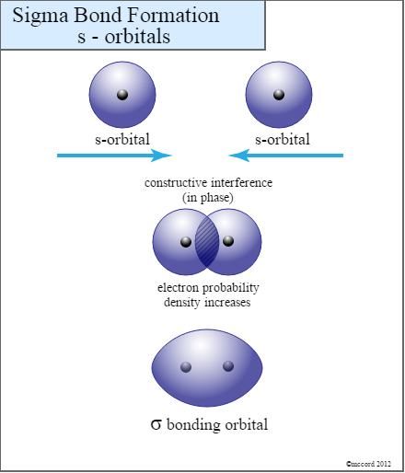
Sigma bonds
Along the internuclear axis
Increased electron probability density Between 2 nuclei
Lobes of two orbitals overlap end to end

Slide 10
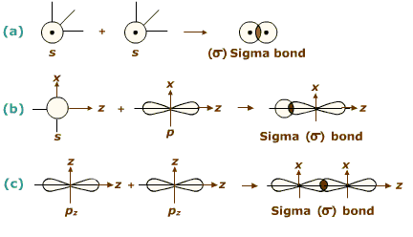
??????
Sigma bonds

Slide 11
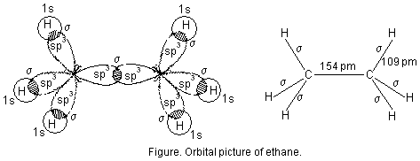
Example: Ethane C2H6

Slide 12
(Dufferin-Peel Catholic District School Board, 2012)
Pi bonds
Parallel to the internuclear axis BUT...
Electron probability = 0 @ internuclear axis
Electron probability divided into 2 regions. (2 chucks = 1 pi bond!)
Increased electron probability density above and below 2 nuclei
Lobes of two orbitals overlap side to side

Slide 13
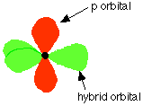
Example: Ethene C2H4

Slide 14
Sigma bonds | Pi bonds
Single and multiple bonds | Multiple bonds only (forms only in addition to a sigma bond)
head-on overlapping of atomic orbitals | Sideway overlapping
Along the internuclear axis | Parallel to the inter-nuclear axis
Relatively shorter | Relatively longer
Relatively stronger | Relatively weaker

Slide 15
Sigma bonds | Pi bonds
Symmetrical | asymmetrical
Free rotation is possible | Rotation will break the bond
May exist on its own, may exist without p orbitals | Does not involve s orbitals but can’t form without a sigma bond
Only one lobe of the p-orbital is involved | Both lobes of the p-orbital are involved
Larger overlap area | Smaller overlap area

Slide 16
Now we know the valence electron theory and the 2 types of bonds (read: constructive interference)
BUT…
The valence electron theory is FLAWED.
For instance, carbon is predicted to have 2 bonds for overlapping while it actually has 4. How can we solve this?
And how can we apply the knowledge of sigma/pi bonds to predict the actual 3d geometry of a more complex molecule?

Slide 17
Rozhan

Slide 18
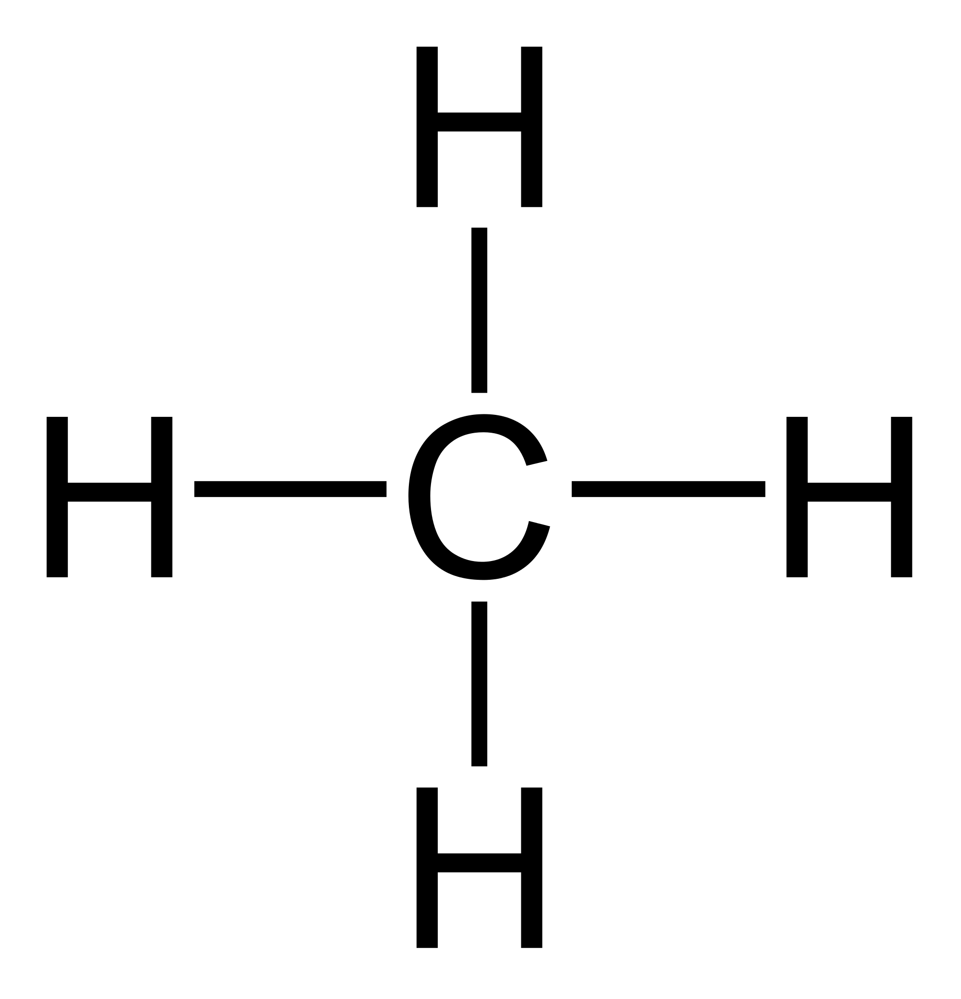
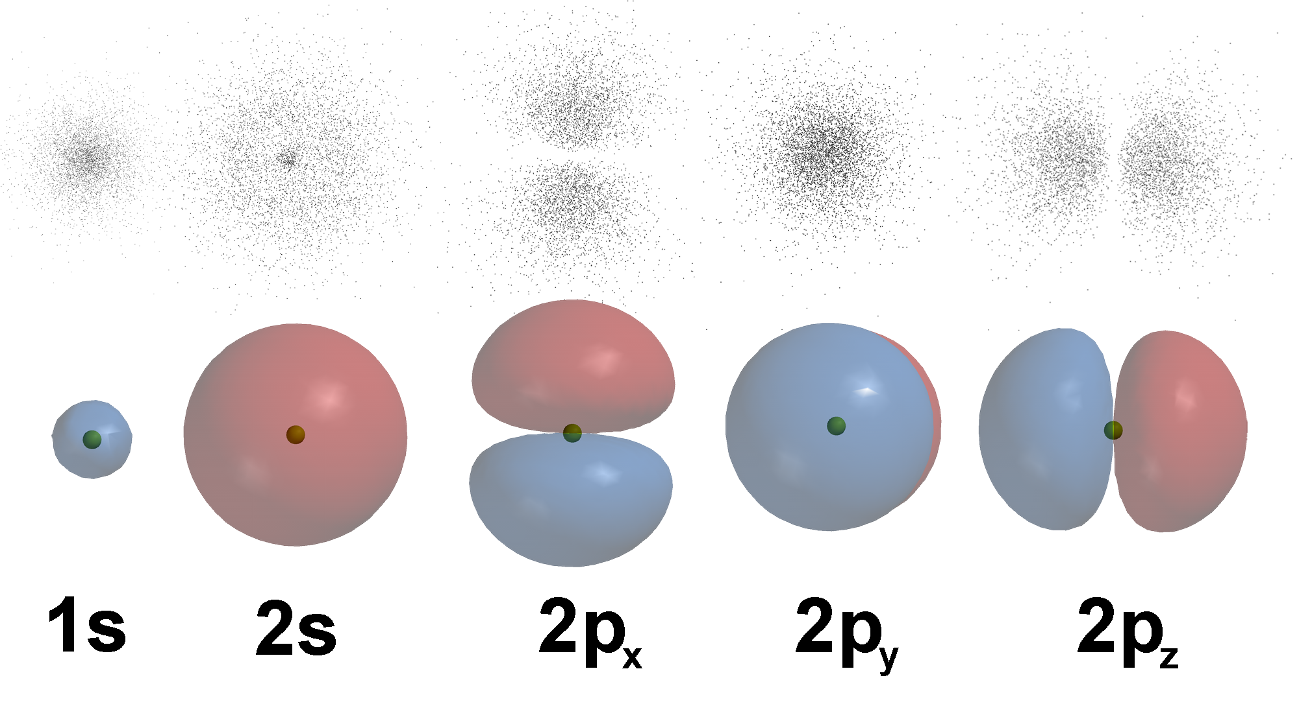
CH₄
HYBRIDIZATION
↿⇂ | ↿ ↿ ↿ ↿
1s² | 2sp³
↿⇂ | ↿⇂ | ↿ ↿ _
1s² | 2s² | 2p²
↿⇂ | ↿⇂ | ↿ ↿ _
1s² | 2s² | 2p²
2 unpaired electrons → 2 bonds??

Slide 19
BeF₂
i i
2p
i i i
2p
↿ ↿ i
2sp
↿⇂
2s²
Energy
Hybridize
↿⇂
1s²
↿⇂
1s²
Linear

Slide 20
BF₃
↿ i i i
2p
i
2p
↿ ↿ i↿ i
2sp²
↿⇂
2s²
Energy
Hybridize
↿⇂
1s²
↿⇂
1s²
Trigonal planar

Slide 21
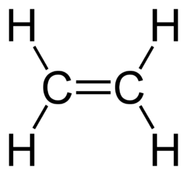
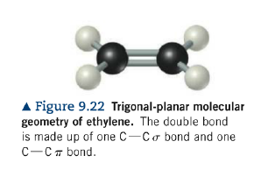
C₂H₄
↿⇂ | ↿ ↿ ↿ |  | ↿ _
1s² | 2sp² |  | 2p¹
↿⇂ | ↿⇂ | ↿ ↿ _
1s² | 2s² | 2p²
Hybridize

Slide 22
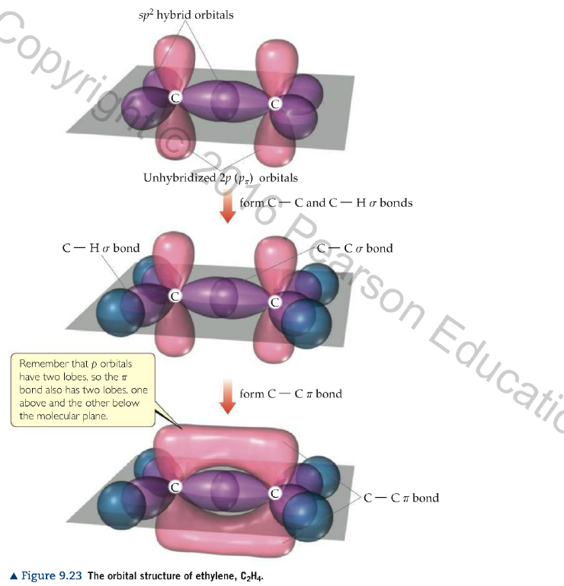
C₂H₄

Slide 23
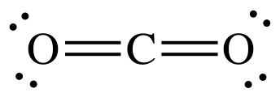
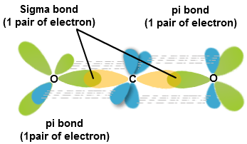
CO₂
↿⇂ | ↿ ↿ |  | ↿ ↿
1s² | 2sp |  | 2p²
↿⇂ | ↿⇂ | ↿ ↿ _
1s² | 2s² | 2p²
Hybridize

Slide 24
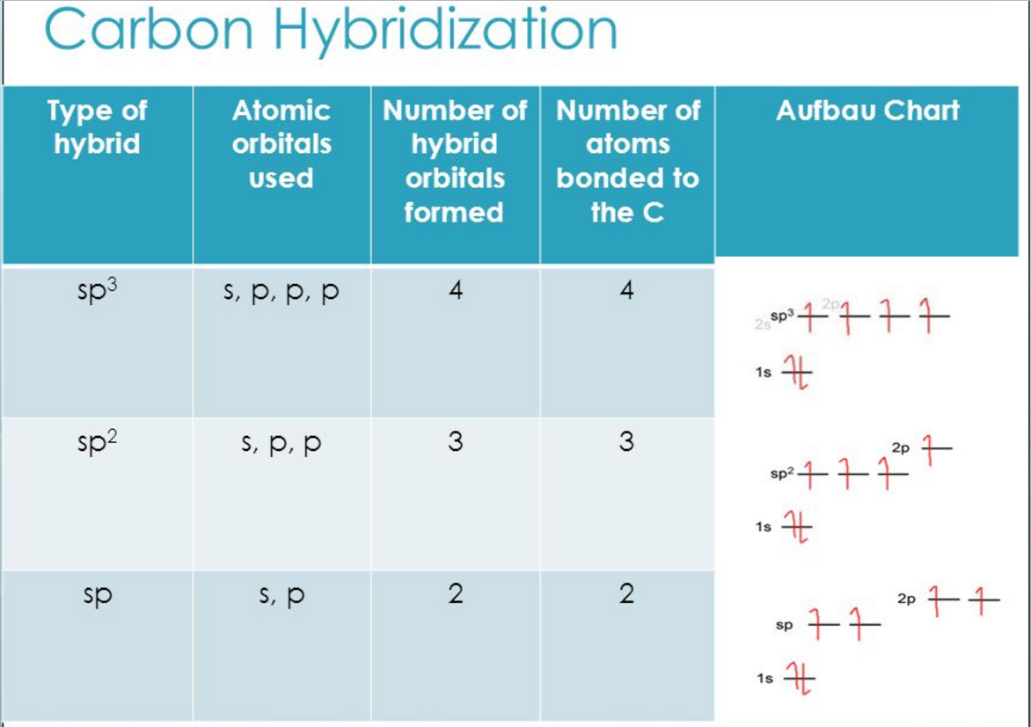
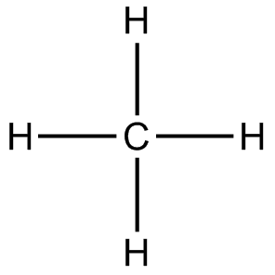
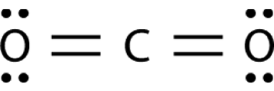

Slide 25
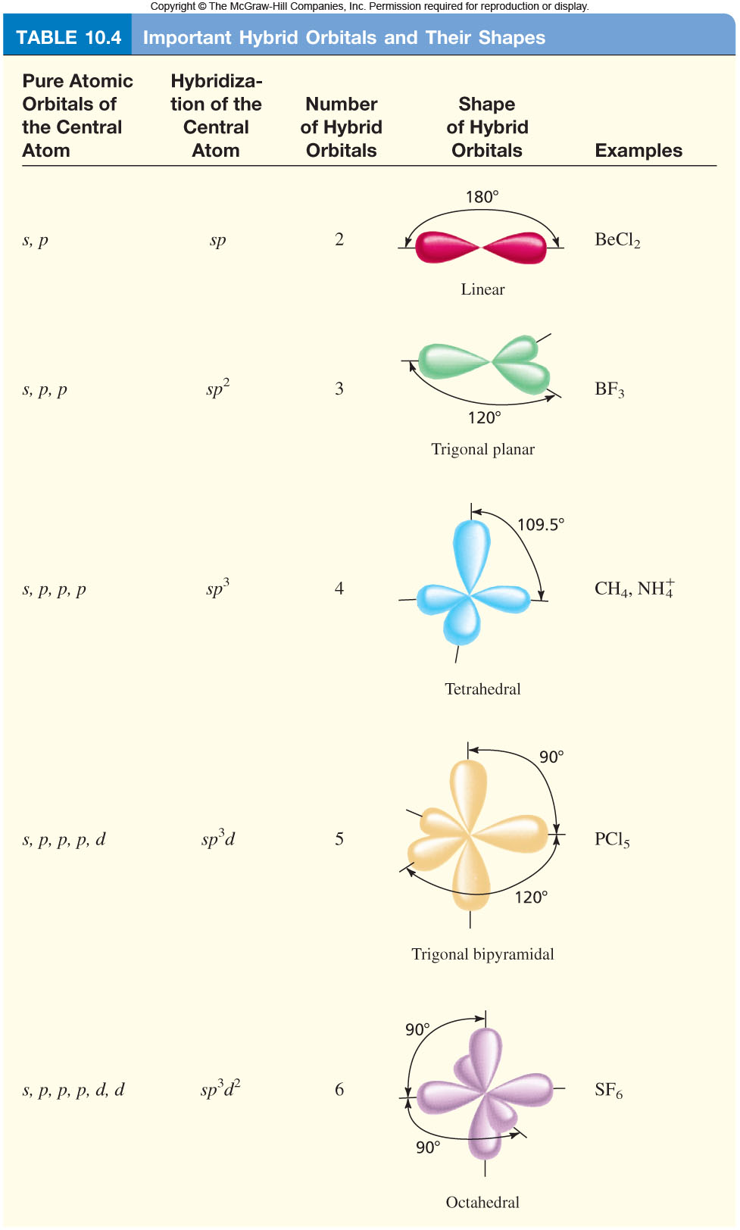

Slide 26
Wrap-up
(CrashCourse, 2013)

Slide 27
Wrap-up

Slide 28
Practice

Slide 29
Kahoot

Slide 30
True or False
Sigma bonds restricts rotation atoms around the bond axis.
Formation of Pi bonds results in higher electron density above and below the bond axis.
Each bond is associated with two overlapped orbitals
Overlapping orbitals always have the same spin number
ANS: F T F F

Slide 31
How many sigma and pi bonds are in there?
SO3
[SO3]2-
[SO4]2-
CH3COOH

Slide 32
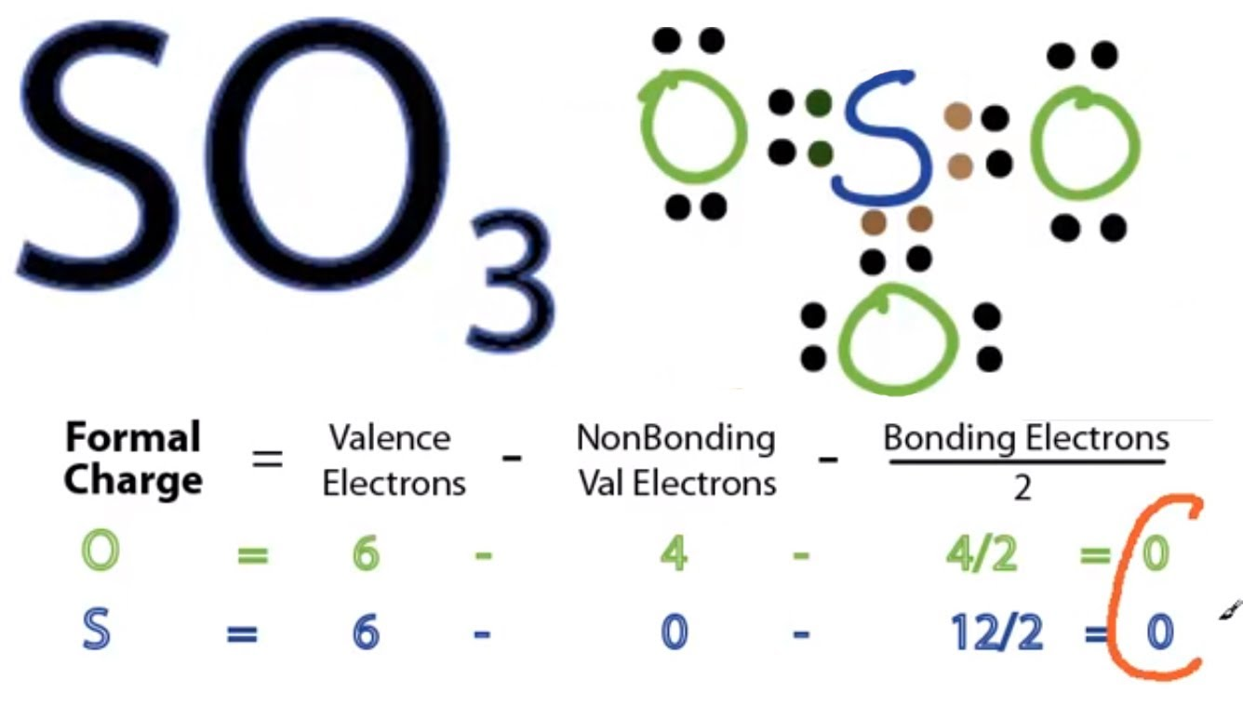
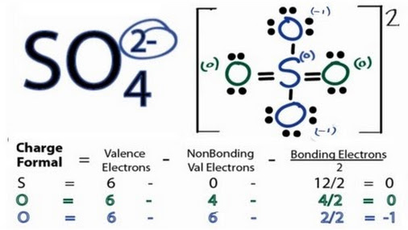
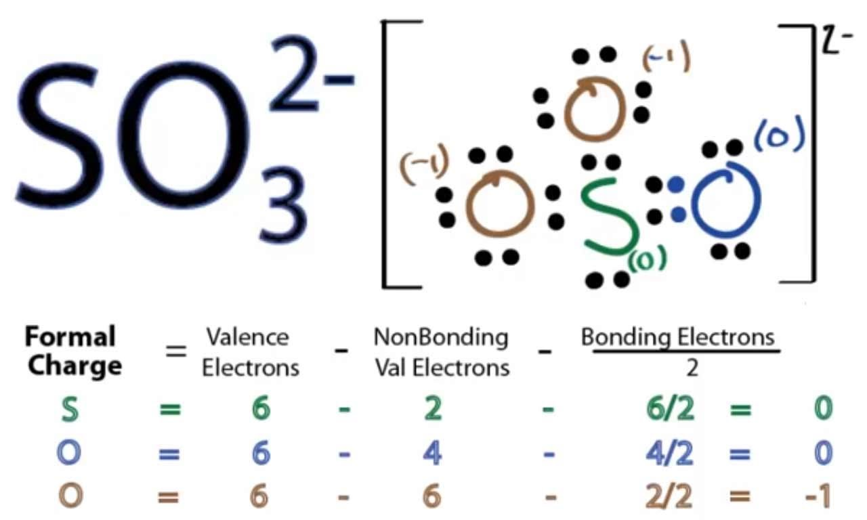
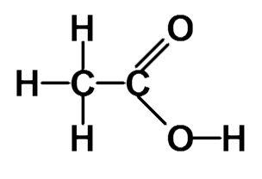
ANS:
3σ3π
3σ1π
4σ2π
7σ1π

Slide 33
Matching
Ethyne
Ethane
Ethene
ANS: 1c 2a 3b

Slide 34
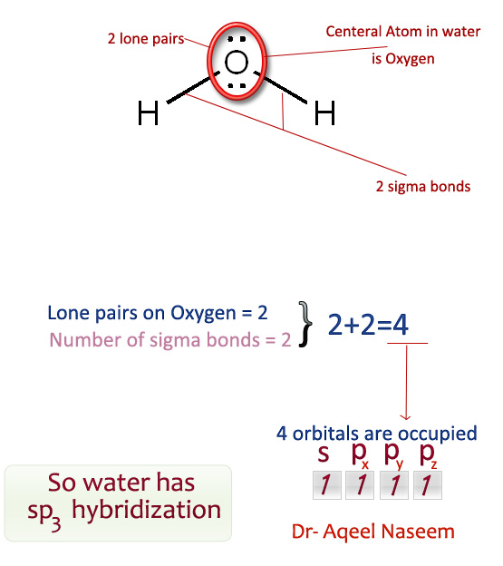
What is the hybridization of an oxygen atom in a water molecule?
sp
sp²
sp³
ANS: sp³

Slide 35
Organic Challenge!(Khan Academy Organic Chemistry, 2014)
Identify hybridization states and predict the geometries for all the atoms except hydrogen

Slide 37
Bibliography
Yau. Chem 121. Retrieved October 20, 2016, from Community College of Baltimore County, http://faculty.ccbcmd.edu/~cyau/zzzzzz%20121%20YAU%20Sp%202015.htm
Jespersen, N. D., Chemistry, ’, St John, & York, N. (2014). Barron’s AP chemistry, 7th edition (7th ed.). Albany, NY, United States: Barron’s Educational Series Inc.,U.S.
Quantum Mechanics and Bonding Hybridization. (n.d.). Lecture. Retrieved October 20, 2016, from http://www.dpcdsb.org/NR/rdonlyres/9B6E4EF6-77F0-407F-A858-F0DF78B6896C/106061/46QuantumMechanicsandBondingHybridization.pdf
Khan Academy Organic Chemistry (2014, May 17). Organic hybridization practice | chemical bonds | chemistry | khan academy Retrieved from https://youtu.be/GuaozMpFS3w
CrashCourse (2013, August 5). Orbitals: Crash course chemistry #25 Retrieved from https://youtu.be/cPDptc0wUYI

Slide 38
Thanks!
Rozhan Akhound-Sadegh
Charlotte Anjun Hu
Jessica Yihong Lu

