Slide 1
Lewis Structures
Malcolm, Xavier, Genna

Slide 2
Octet Rule
-Small molecules and polyatomic ions can use basic octet rule.
-Larger molecules, determine general arrangement of atoms, skeleton.
-Always includes central atom, atoms surrounding it bonded.

Slide 3
Few Octet Rules
Carbon usually central atom. If more than one carbon, joins together to start skeleton.
Hydrogen never central atom, only one covalent bond.
Halogens generally not central because only forms single bonds when oxygen not present.
Oxygen rarely central atom, only forms two covalent bonds. May link two carbons in carbon chain.
In simpler molecules, atom that appears only once will often be central atom.

Slide 4
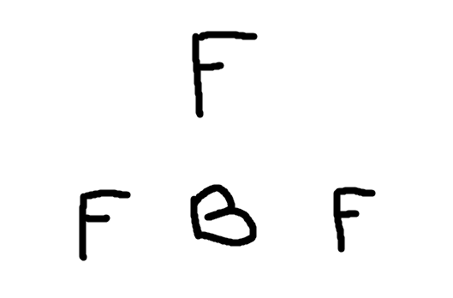
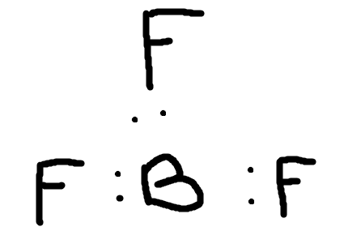
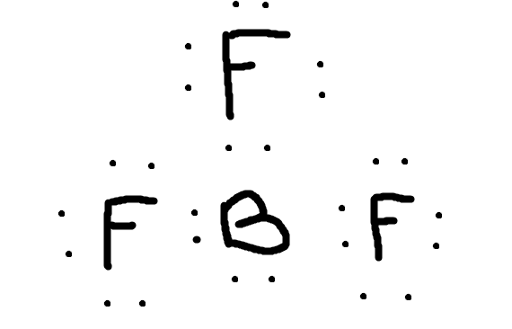
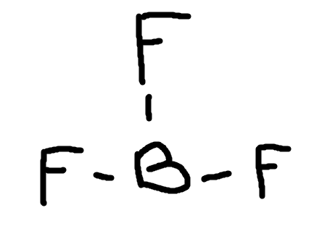
Octet Rule Example Using BF₃
Valence electrons of all atoms added together. 3+7+7+7=24.
For polyatomic ions, must take into account electrons used to form ion.
Pair of electrons between each two atoms, bonding pairs.
Remaining electrons complete octets, nonbonding pairs.
Any Electrons leftover added in pairs to central atom.
When all electrons placed, outer atoms will all have octets. Central atom can vary.
Skeleton
Bonding Electrons
Outer Octets Complete
Line Structure

Slide 5
Octet Rule For Central Atom
If central atom has octet, structure is complete.
If central atom is boron, can have less than eight electrons. If any other atom, double bonds must be made.
For atoms in periods 3 to 7, central atom can have more than eight electrons.

Slide 6
Exceptions to the octet rule
Incomplete Valence shells:
Some ions/species that when combined have only seven electrons in their valence shells are called free radicals
Those when combined, that have only six electrons in their valence shell are called Carbenes
Both Free Radicals and Carbenes are extremely reactive as they want one or two more electrons to become stable

Slide 7
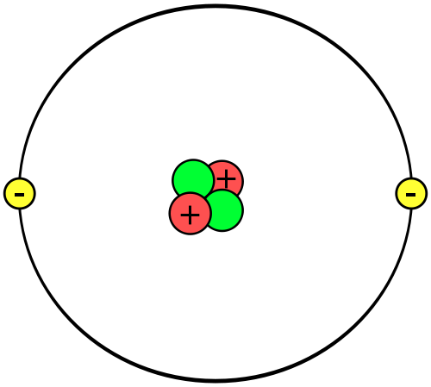
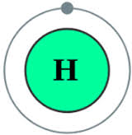
Duet and Duodecet Electron Rules
Duet Rule:
All atoms can only have a maximum of two electrons in their initial (first) shell. (Hydrogen and Helium will only ever fill these shells)
18 Electron Rule:
Valence shells of transition metals have nine orbitals, and can accommodate a total of 18 electrons (After filling all nine orbitals and having 18 valence electrons these metals are said to have the same configuration as noble gases.
Duodecet Rule:
New theories do not count the P-orbital in the metals, and therefore mean these metals will only have 12 valence electrons and eight orbitals (one S-orbitals, and five D-orbitals)
While recognized, this rule hasn’t been adopted by the entirety of the chemistry world as of yet

Slide 8
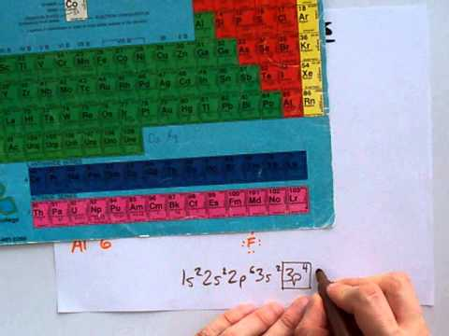
Which atoms can disregard the octet rule:
This video shows which atoms (most/all of them) can disobey the octet rule

Slide 9
Lewis Structures of Ions
Example: NO₂⁻
Add electrons: 6+6+5=17, charge makes it 18.
Nonbonding Pair Added to N
Skeleton
Nonbonding Pair from Left O Are Moved to Make a Bonding Pair
Bonding e⁻ Added
Line-Dot Structure (On AP Exam)
Octets Around O Complete
Line Structure (Not on AP Exam)

Slide 10
Lewis Structures of Odd Electron Compounds
Total number of valence electrons odd number, impossible to construct Lewis structure with octet around each atom.
Ex: Nitrogen dioxide
Lewis structures with unpaired electrons often called free radicals.
Unusually reactive.
In effort to pair up single electrons, free radicals may form dimers or pairs of molecules.
Ex: 2NO₂ → N₂O₄ (dimerizes)

Slide 11
Questions
Build the Lewis structure for each of these compounds:
CH3Cl
CS2
PH3
Now build them for these ions:
NO3 (-)
ClO4 (-)
SO3 (-2)

Slide 12
Formal Charge
Compares the electron count of the atom to an isolated neutral atom
Formal Charge = (number of valence electrons) - (number of bonds it forms) - (number of lone pair electrons)

Slide 13
Formal Charge Using Sulphate

Slide 14
Formal Charge Using Sulphate
VE - 6 6-4-4 = 0
NB - 2
LPE - 4
VE - 6
NB - 1
LPE - 6
6 - 1 - 6= -1
VE - 6
NB - 6
LPE - 0
6 - 6 - 0= 0
VE - 6
NB - 1
LPE - 6
6 - 1 - 6= -1
VE - 6 6-4-4 = 0
NB - 2
LPE - 4
Total Charge
0+0+-1+-1+0 = -2

Slide 15
Resonance Structures
When more than one Lewis structure can be drawn for the same ion, it is said to have resonance.
Each structure that can be drawn is called a contributing resonance structure
Double headed arrows indicate the contributing resonance structures
The actual lab findings, however, find that none of these different structures are not the actual structure - bonds are distributed over entire molecule
Actual structure called a resonance hybrid structure

Slide 16
Resonance Structure Using Carbonate
There isn’t a double bond, all the bonds are the same length - combination of all three structures

Slide 17
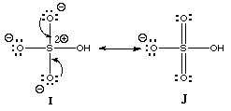
Rules When Drawing Resonance Structures
All resonance structures must have the same number of electrons
The octet rule must be obeyed
The nuclei cannot change places

Slide 18
Examples
Draw the following resonance structures:
NO₃⁻
Benzene (C₆H₆ )
ClO₄⁻

Slide 19
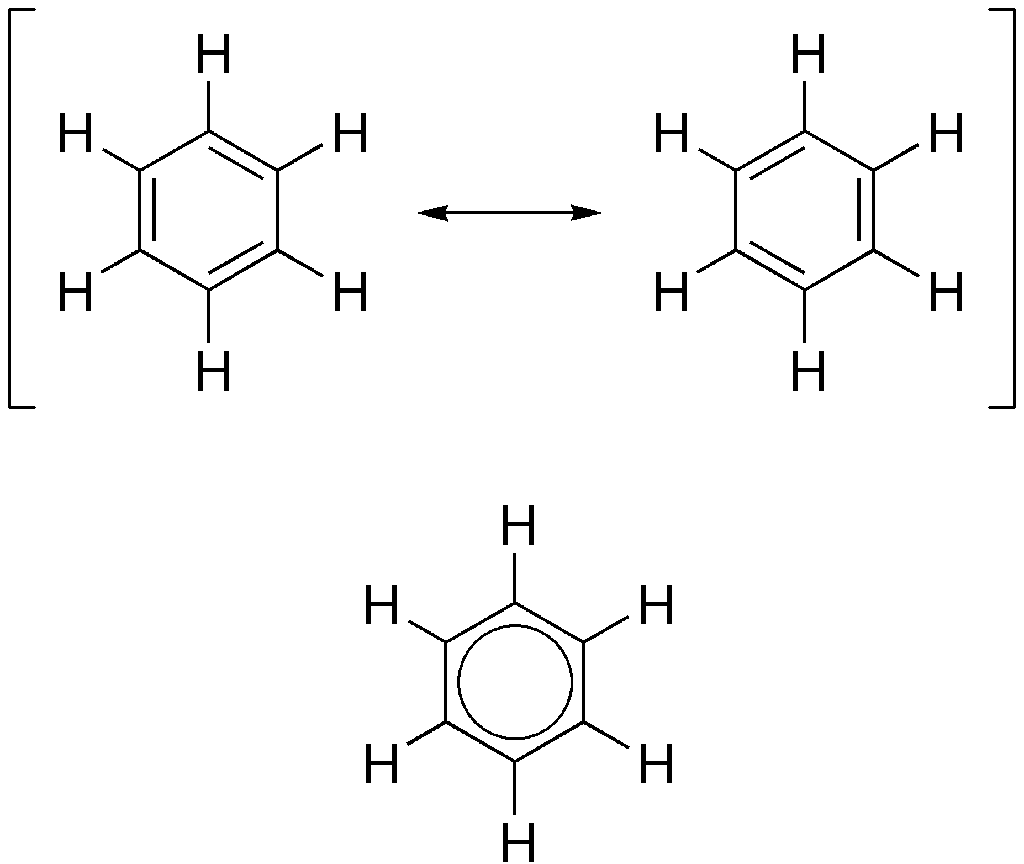
Answers

