Slide 1
VSEPR Diagrams
Presented by Conner, Luc, Allen (RIP), and Radin

Slide 2
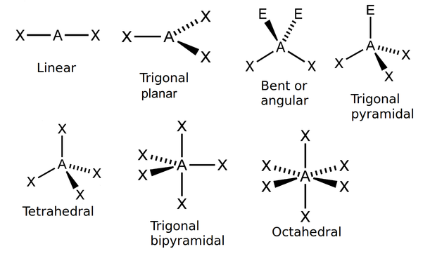
What is a VSEPR Diagram?
Remember these things, from Chem last year?
Models how molecules take up 3D space on a 2D plane
Into Page
Out of Page
Notes:
The VSEPR theory allows us to determine the 3D shape of a covalently bonded molecule with minimum information.
As a simpler explanation VSEPR models are just 3D Lewis diagrams

Slide 3
Terminology
Bonding Orbitals: Electron orbitals shared between molecules
Lone Pair Orbital: Hmmm, wonder what this is...
Hybridization: Mixing atomic orbitals into new hybrid orbitals.
Electron Domain: # of lone pairs or bond locations around a particular atom in a molecule.

Slide 4
VSEPR Theory “rule of thumb”
Electrons spread out
Lone pairs are close to atom, whereas bonding pairs shift further apart from the central atom.
Due to the different amount of repulsion by the lone pair and bonding pairs, therefore:
Lone Pair repulsion > Bond-Lone pair repulsion > Bond Pair repulsion

Slide 5
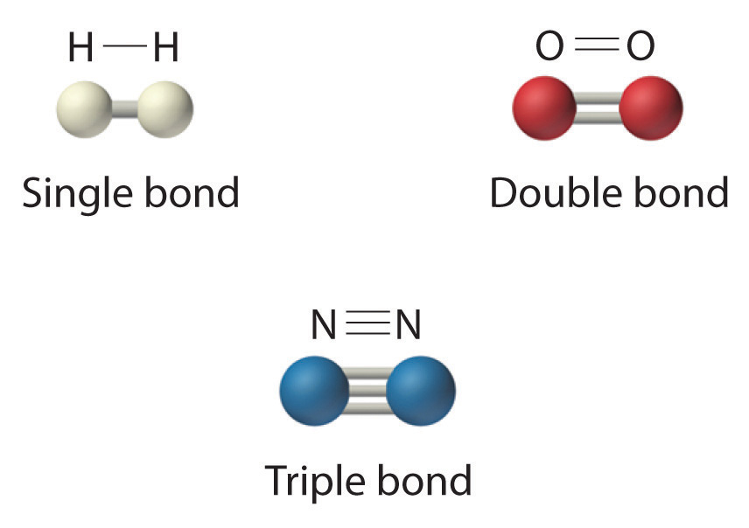
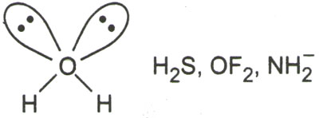
Notes
ALL THE SAME
Lone Pairs make it bent, and give it name “Bent”

Slide 6
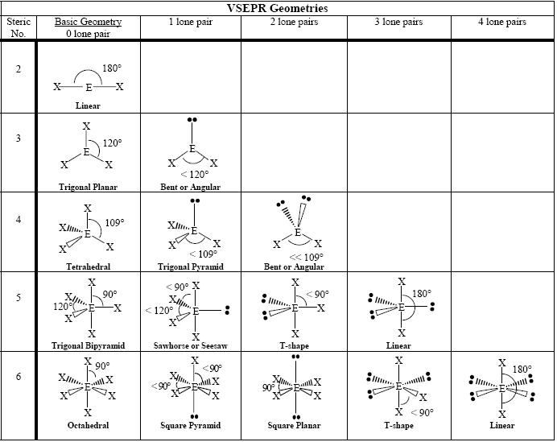
Molecular Geometry
Linear
Trigonal planer
Tetrahedral
Trigonal bipyramidal
Octahedral

Slide 7
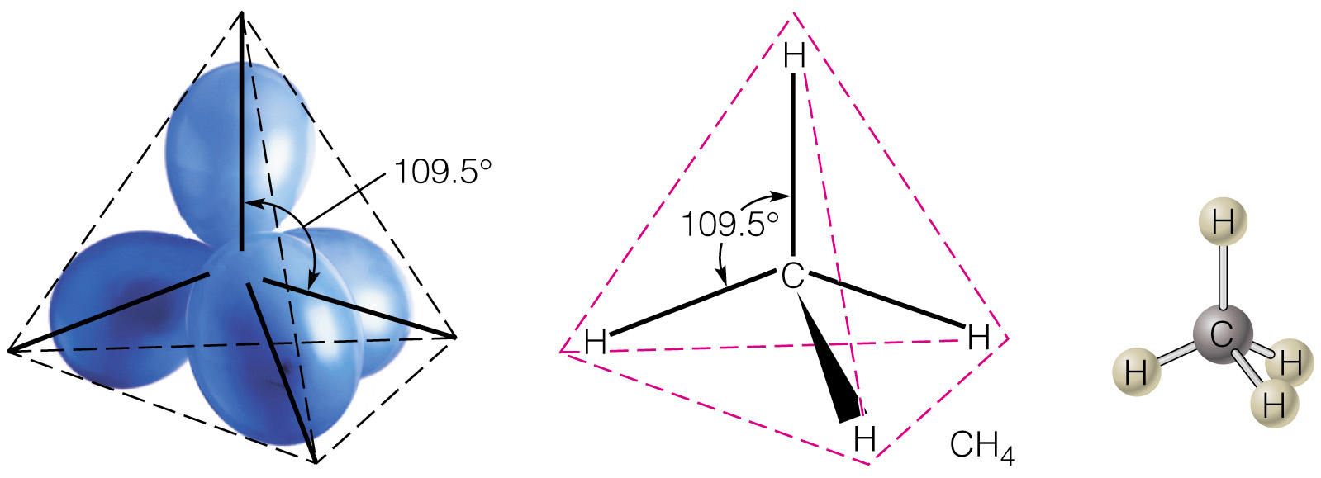
Balloons Demo
Why do molecules acquire these shapes?

Slide 8
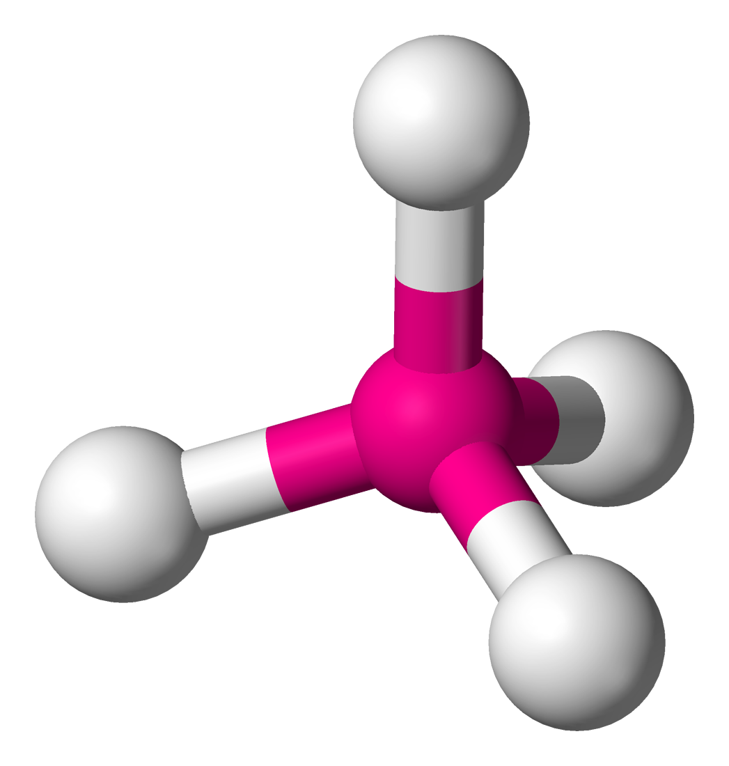
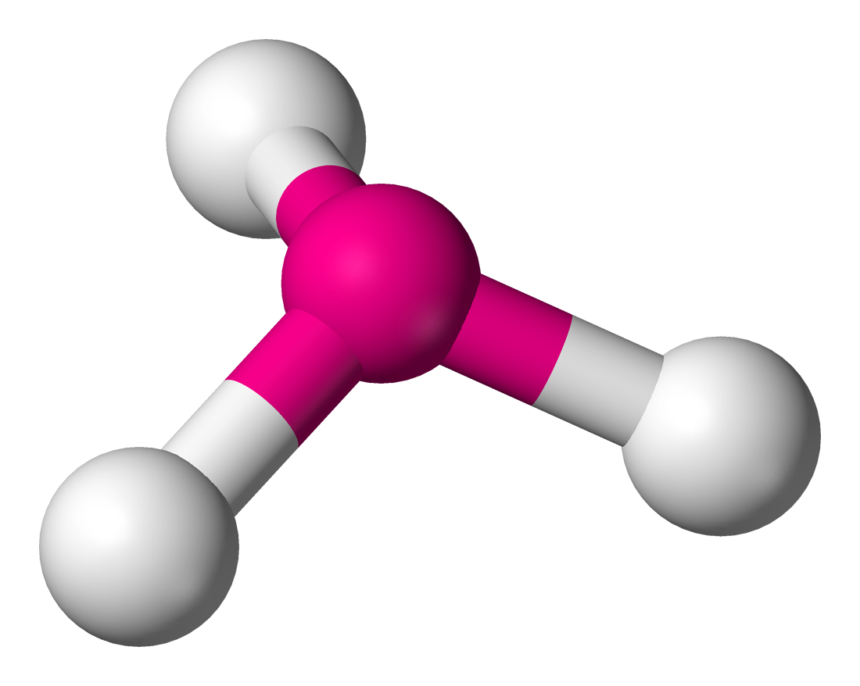
Derived Structures
Derived structures: bonds replaced with lone pairs.
Example: Square pyramidal is a derived structure of an Tetrahedral.

Slide 9
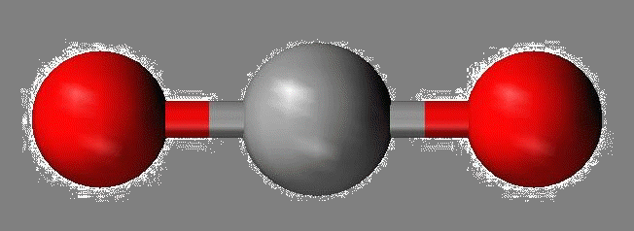
Properties of Linear Molecular Shape
2 Electron Pairs
Have a sp hybridization
0 lone pairs
Acquire a 180º angle
Example: BeH₂

Slide 10
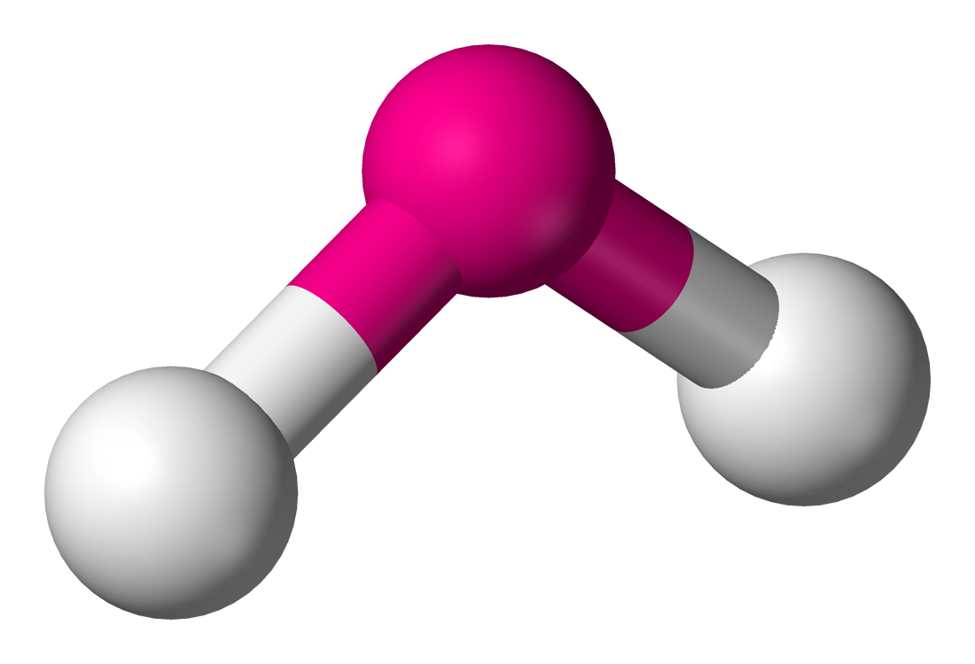
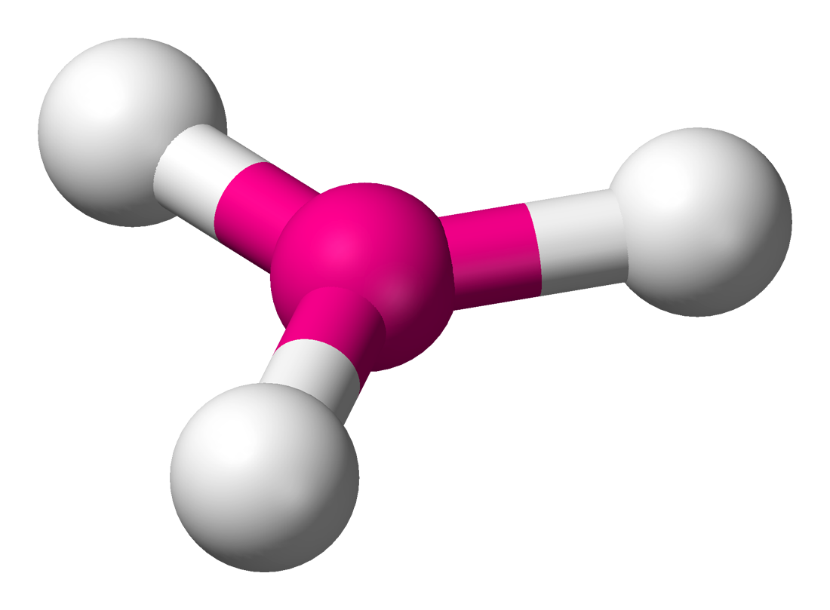
Properties of trigonal planar (2 cases)
3 Electron Pairs
Have a sp² hybridization
0 lone pairs or 1 lone pair
Acquire a 120º angle or <120º
If 1 lone pair, then it is called a “bent” shape.
Examples: BF₃, SO₂

Slide 11
Properties of tetrahedral (3 cases)
4 Electron pairs
Sp³ hybridization
0 or 1 or 2 lone pairs.
Acquire a 109º or <109º or <<109º angle.
1 lone pair - “trigonal pyramidal”, or “bent”
2 lone pair - “bent”
Examples: CH₄, NH₃, H₂O

Slide 12
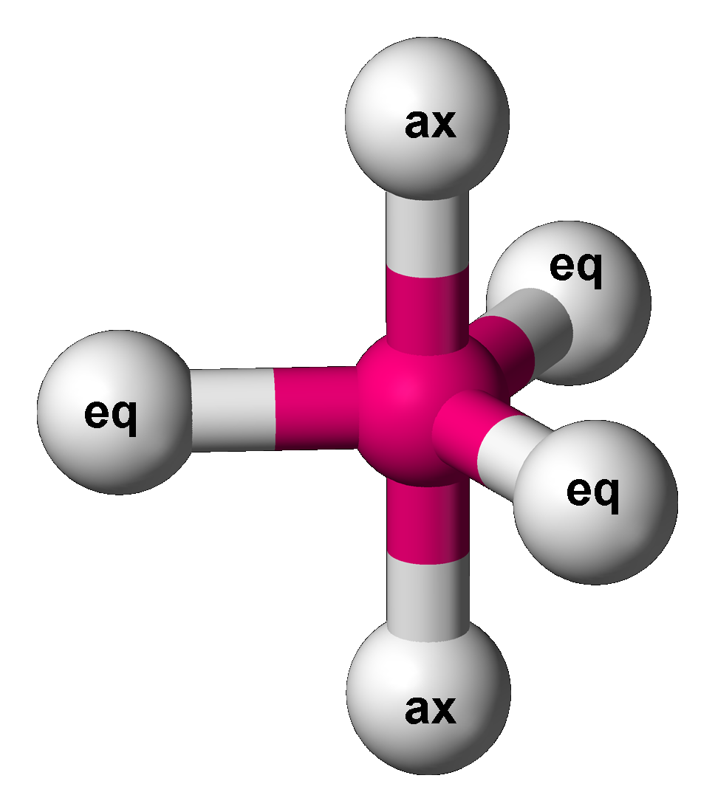
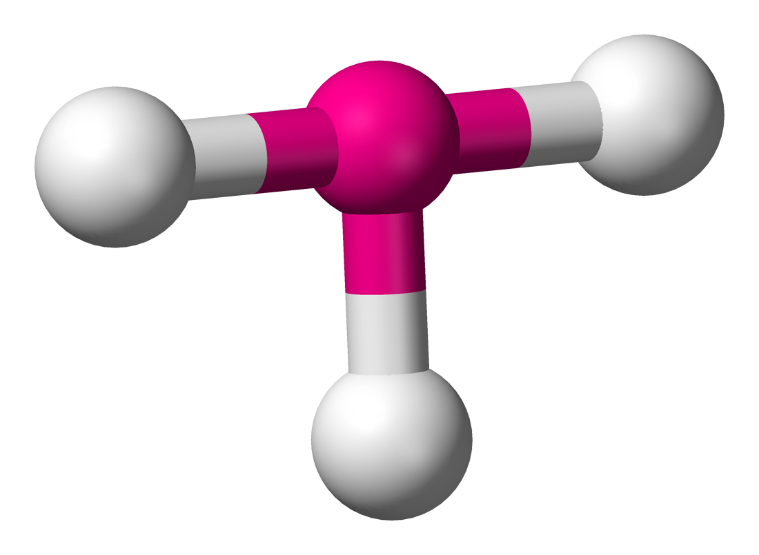
Properties of trigonal bipyramidal (4 cases)
5 Electron pairs
Sp³d hybridization
0,1,2 or 3 lone pairs.
Acquire a 120º, 90º or both.
1 lone pair - “folded square”
2 lone pair - “T-Shaped”
3 lone pair - “Linear”
Example: PCl₅, SF₄, ClF₃, XeF₂

Slide 13
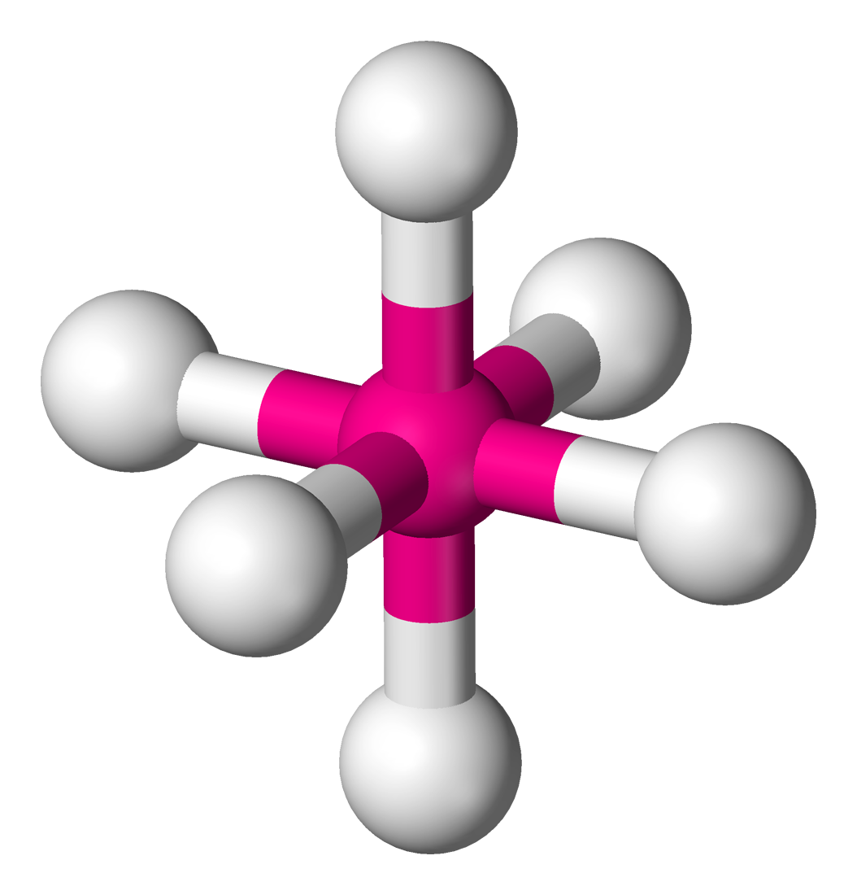
Properties of octahedral (5 cases)
6 Electron pairs
Sp³d² hybridization
0,1,2, 3 or 4 lone pairs.
Acquire a 90º, depending on shape.
1 lone pairs - “square pyramidal”
2 lone pairs - “square planar”
3 lone pairs - “T-Shaped”
4 lone pairs - “Linear”
Examples: SF₆, IF₅, XeF₄

Slide 14
Basic Structures for Six Geometries using the form AX
Notation | Shape | Example | Angle(s)
AX | Linear | HBr | ----
AX₂ | Linear | CS₂ | 180º
AX₃ | Planer triangle | BCl₃ | 120º
AX₄ | Tetrahedron | CCl₄ | 109.5º
AX₅ | Trigonal bipyramid | PCl₅ | 120º, 90º
AX₆ | Octahedron | XeF₆ | 90º

Slide 15
Derived Structures in the form AXE
Notation | Derived Structure Notation | Shape | Example | Angle(s)
AX₃ | AX₂E | Bent | SnCl₂ | 120º
AX₄ | AX₃E | Triangular Pyramid | NH₃ | 109.5º
AX₄ | AX₂E₂ | Bent | H₂O | 120º
AX₅ | AX₄E | Distorted Tetrahedron | IC₃ | 90º
AX₅ | AX₃E₂ | T-Shape | ICl₃ | 90º
AX₅ | AX₂E₃ | Linear | I₃ | 90º

Slide 16
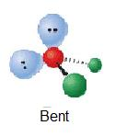
Enough Theory: How Do I Answer Questions?
Example 1:
Lets try determining the geometric structures of H2O and CO2. So starting off by drawing the Lewis structure:
H2O:
8e = 4 electron groups = tetrahedral for the electron-group geometry: 2 bonding pairs and 2 lone pairs. Since water has two lone pairs it's molecular shape is bent.

Slide 17
Lets test our knowledge

Slide 18
Construct a VSEPR diagram and predict the shape of each of the following molecules and ions:
CH₃Cl
SiF₄
NO₂⁻
ClO₄⁻
PH₃

Slide 19
Answers
Tetrahedron
Tetrahedron
Bent
Tetrahedron
Triangular pyramid

Slide 20
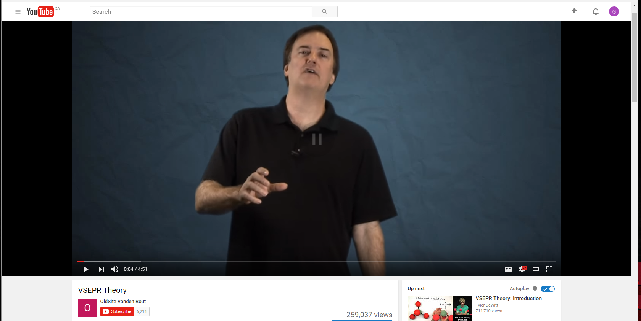
Video Resources
Tyler DeWitt
OldSite Vanden Bout
Professor Dave Explains

